Slide 1

Final Project - Car Price Prediction
BANA 4080 – Data Mining

Slide 2
Introduction
Problem: “A Chinese automobile company Geely Auto aspires to enter the US market by setting up their manufacturing unit there and producing cars locally to give competition to their US and European counterparts. They have contracted an automobile consulting company to understand the factors on which the pricing of cars depends. Specifically, they want to understand the factors affecting the pricing of cars in the American market, since those may be very different from the Chinese market.”
Our Objectives:
Creating various models to determine which would be the most helpful for determining car price.
Determining which variables are most important in determining price
The Dataset:
Based on various market surveys, the consulting firm has gathered a large dataset of different types of cars across the American market.
The dataset has 26 variables and 205 observations (rows)
Notes:
Katie

Slide 3
Introduction
Project Includes:
Some findings of the EDA process include:
No missing data
Outliers in the ohc engine type variable
Positively Skewed data for horsepower and car width
Much larger amount of fwd drive cars than 4fd cars
And a strong positive relationship between price and curbweight
Models used: After reviewing the full data set, we decided to use the models Neural Net, Trees, and the Forward/Backward/Stepwise regression models
Notes:
Katie

Slide 4
Introduction
Summary of Findings:
The Neural Net findings came to 1 hidden layer with 3 nodes to have the lowest RMSE of 2861
The best tree model includes 7 rules, which has a lower RMSE than the full tree and best pruned tree
Of the exhaustive models, the backward selection model has the best RMSE as well as the best AIC
Notes:
Katie

Slide 5
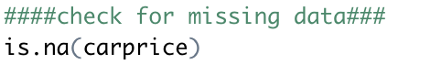
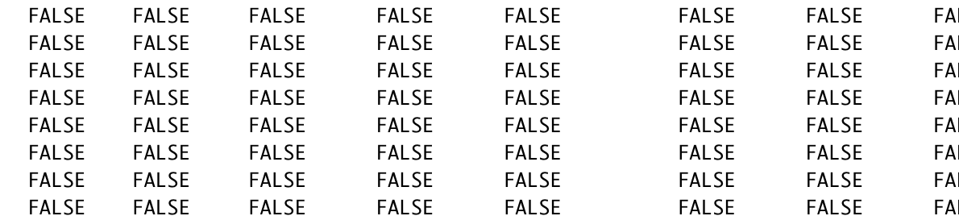
Missing Data?
No Missing Data!
Notes:
Jillian

Slide 6
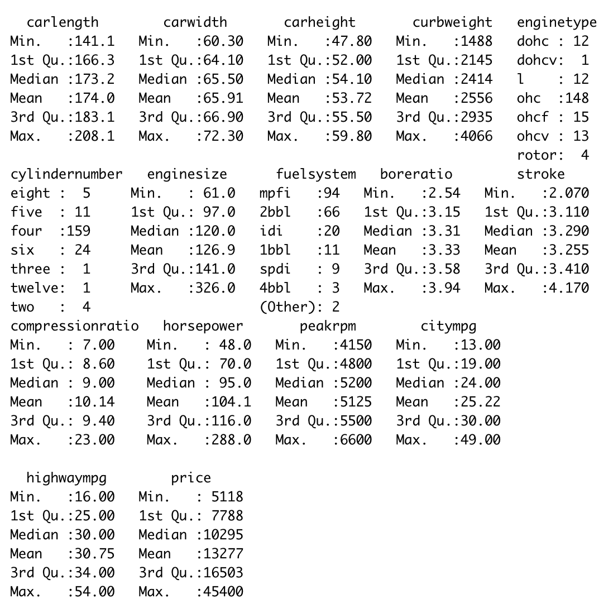
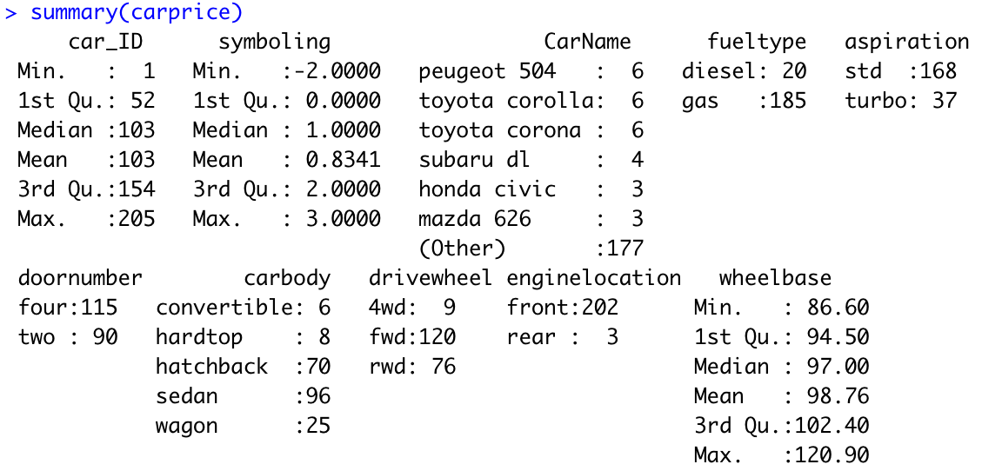
Summary of Plots
Notes:
Jillian

Slide 7
Numerical Variables
symboling - This is a risk factor assigned to the car associated with its price. It ranges from a -3 to 3 scale, with -3 being the least risky and most likely safe and +3 being most risky.
wheelbase - Ths is the distance between the centers of the front and rear wheels (in inches).
carlength - This is the full length of the car from front to back (in inches).
carwidth - This is the width of the car from side to side (in inches).
carheight - This is the height of the car (in inches).
curbweight - This is the weight of the vehicle including a full tank of fuel and all standard equipment (in lbs).
enginesize - This is the size of the car’s engine.
boreratio - This is the diameter of the cylinder bore divided by the piston stroke length.
stroke - This is the length the piston must travel from top to bottom in the engine.
compressionratio - This is the ratio between the volume of the cylinder and combustion chamber in an internal combustion engine at their maximum and minimum values.
horsepower - This is the power the engine produces.
peakrpm - This is the maximum engine speed measured in revolutions per minute.
citympg - This is the miles per gallon the car gets while driving in a city.
highwaympg - This is the miles per gallon the car gets while driving on the highway.
price - This is the price of the car (in USD). This is the key variable we will be using for our predictions and finding correlations between the other variables with this one.
Notes:
Jillian

Slide 8
Categorical Variables
CarName - This is the make and model of the car.
fueltype - This is the type of fuel the car runs on (diesel or gas).
aspiration - This is how the car intakes air. It can be either standard (std) or turbo. There were no supercharged cars in dataset.
doornumber - This is the number of doors on the car (two or four).
carbody - This is the body type of the car (sedan, hatchback, convertible, wagon, hardtop).
drivewheel - This is the wheel of the car that transmits force (two-wheel drive (2wd) or four-wheel drive (4wd)).
enginelocation - This is the location of the engine in the car (front or rear).
enginetype - This is the type of engine in the car. This can either be OverHead Cam (ohc), Dual OverHead Cam (dohc), OverHead Cam and Valve (ohcv), Dual OverHead Cam and Valve (dohcv), OverHead Cam and Valve F engine (ohcf), Rotary engine (Rotor), and L engine (l).
cylindernumber - This is the number of cylinders in the engine of the car (two, three, four, five, six, eight, or twelve).
fuelsystem - This the type of fuel system the car has (mpfi, mfi, idi, spfi, 1bbl, 2bbl, or 4bbl).
Notes:
Jillian

Slide 9
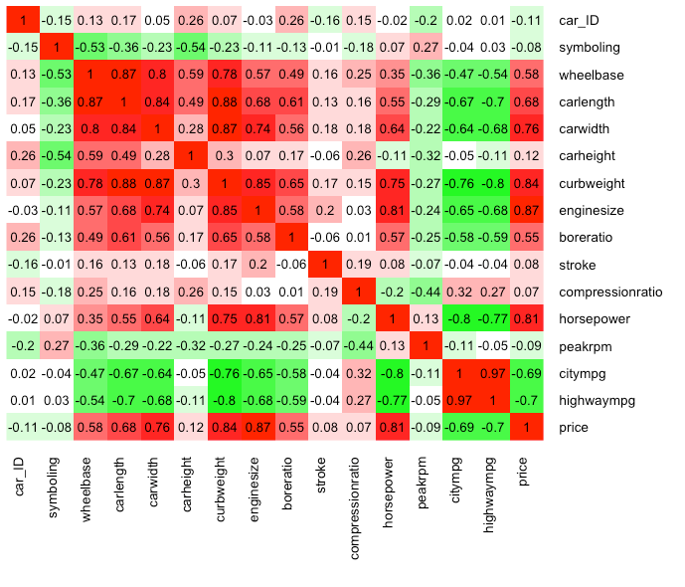
Multicollinearity
No high correlation to cause multicollinearity
This is positive for the dataset has strongly correlated values, but not in a way that would mess with the data
Notes:
Jillian

Slide 10
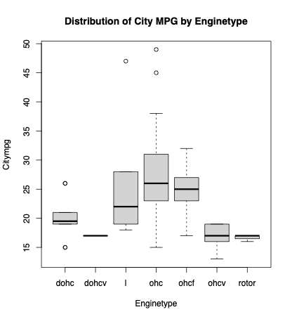
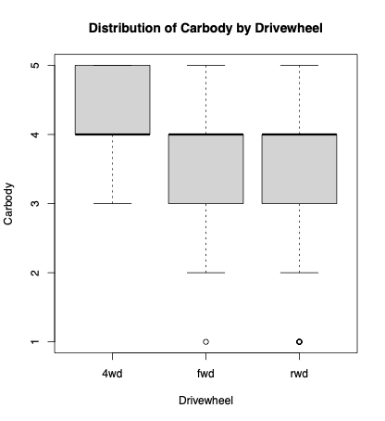
Box Plots
Notes:
-The medians in the distribution of city mpg by engine type seem to be all over the place and we can see some major outliers for the ohc engine type
Jillian

Slide 11
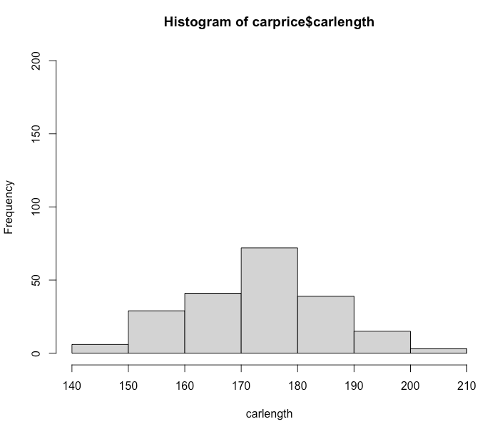
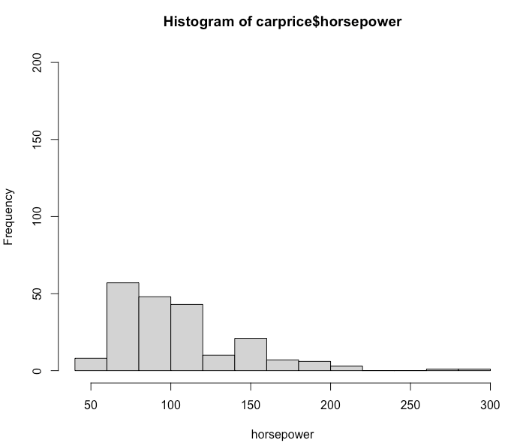
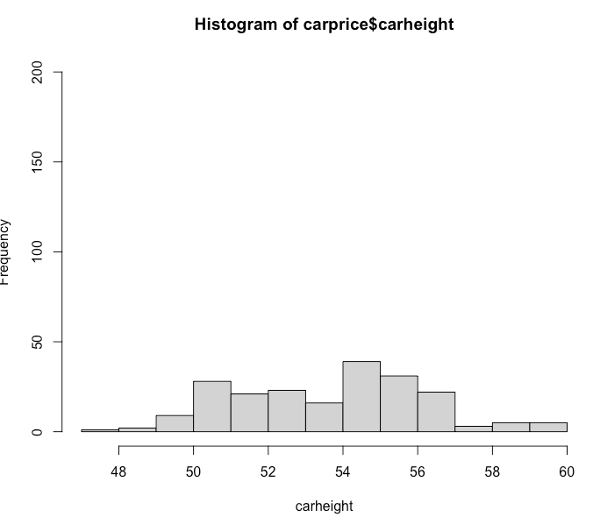
Histograms - Distribution of Variables
Symmetric
Positively Skewed data for horsepower and car width
Notes:
Jillian

Slide 12
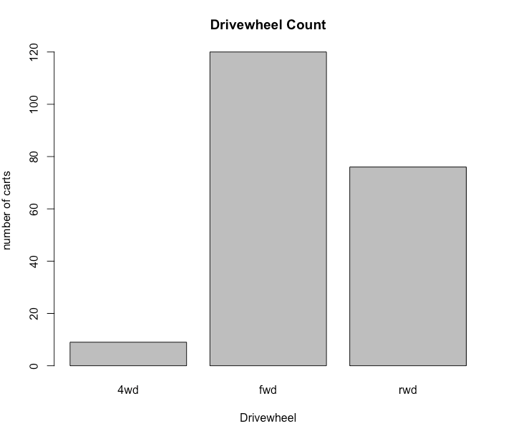
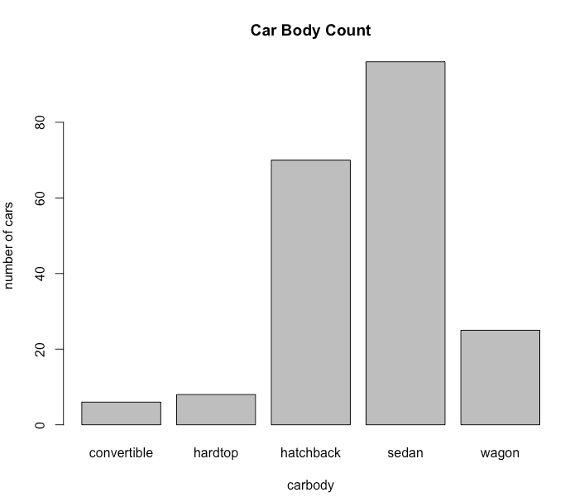
Bar Charts
Large count of fwd drive cars in our data
Large count of sedan cars in our data followed by hatchback and then wagon
Notes:
Jillian

Slide 13
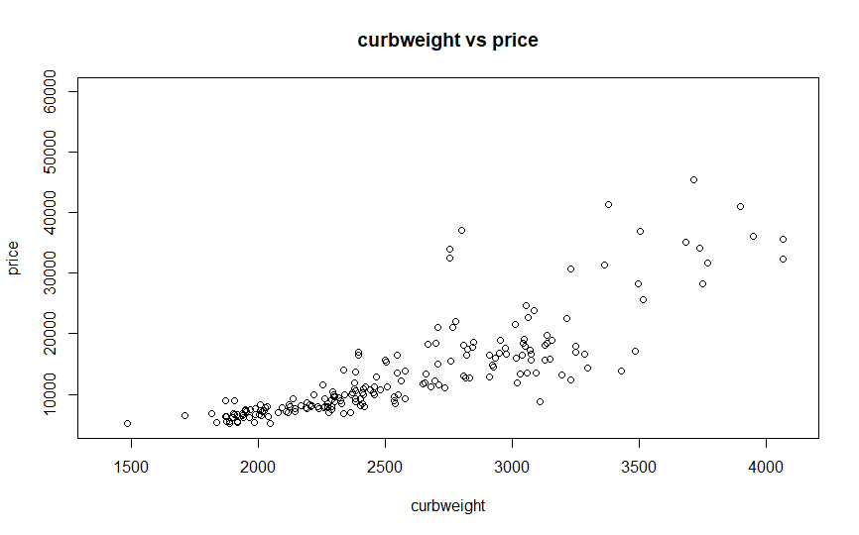
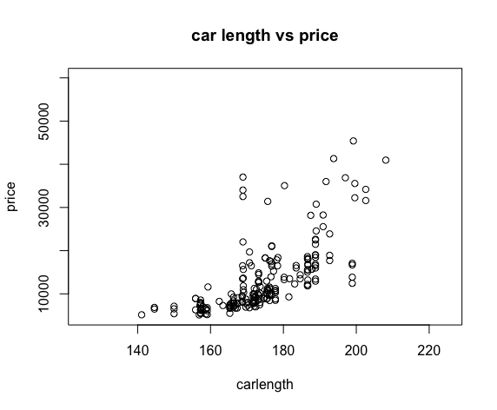
Scatter Plots
There is a strong positive relationship between car weight and price, especially when car weight is between 1500 and 3500.
When the car weight exceeds 3500, there is no obvious relationship between price and car weight
There is a relatively strong positive relationship between car length and price,
Largest amount of car data located where there is a car length of 160-180
Notes:
Katie

Slide 14
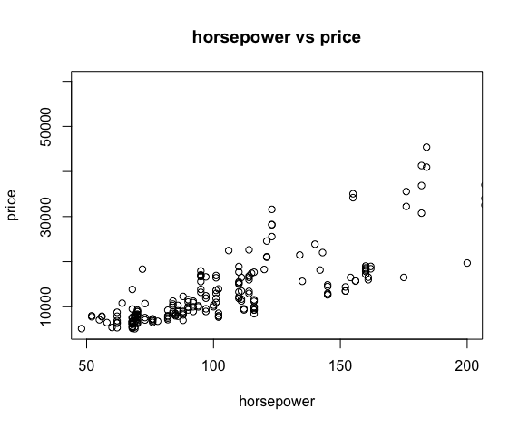
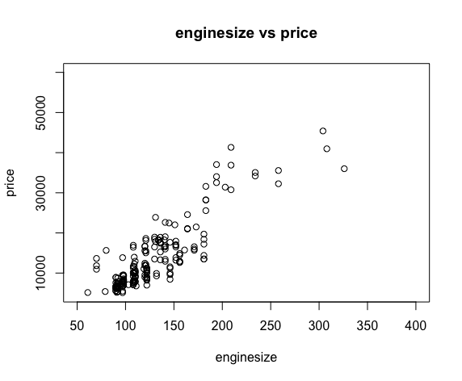
Scatter Plots
There is a relatively strong positive relationship between car horsepower and price
Car data shows not as strong of a positive relationship when the car horsepower is above 125
Car price increases at a great rate when car engine size is > 200
Majority of the car data is located between an engine size of 50 and 200
Notes:
Katie

Slide 15
EDA - summarize findings
We have a large number of cars in our data, followed by hatchbacks, and then trucks.
The data of horsepower and vehicle width are positive skewness
In general, most vehicle structures will affect vehicle prices, and the higher the value, the higher the price. There is a strong positive correlation between them.
The relationship between some vehicle structure and price has a critical value. When the vehicle weight exceeds 3500, there is no obvious relationship between price and vehicle weight. When the horsepower is higher than 125, the positive correlation between them is not so strong.
It is worth mentioning that when the size of the car engine is larger than 200, the car price will rise sharply,
Notes:
Zhou

Slide 16
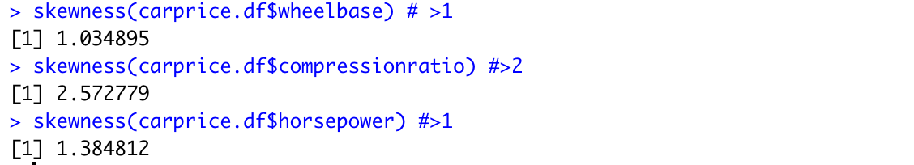
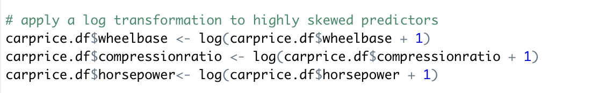
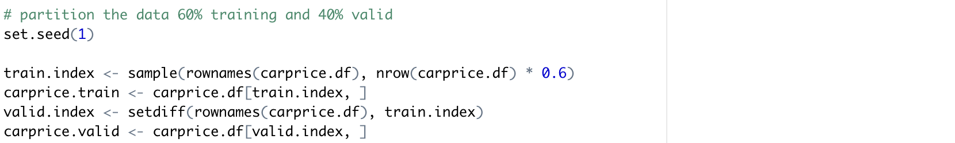
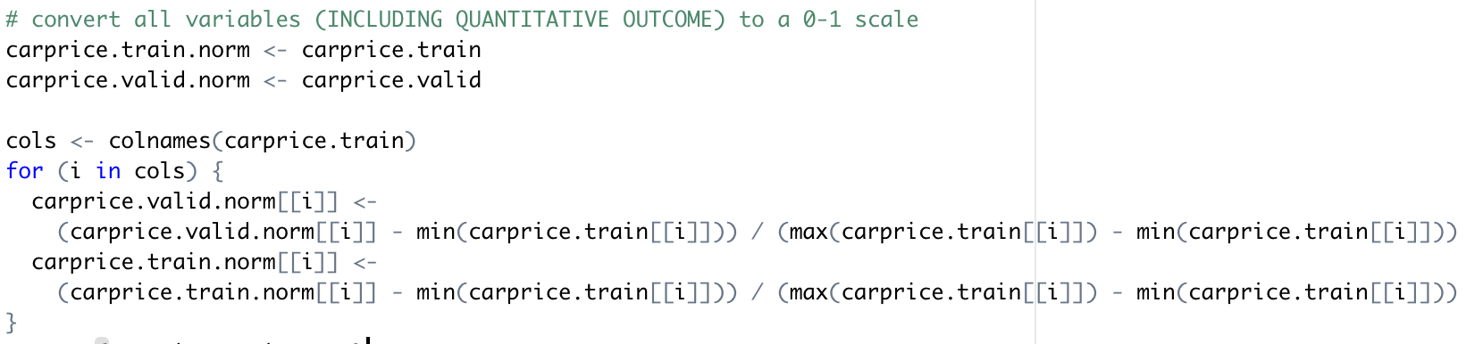
Neural Net _Preprocess
For the Car price data, we remove ID, symboling, carname, enginetype, cylindernumber, and fuelsystem variable
We also create dummy variable for those non numeric variables
Then we check for skewness and wheelbase, compressionratio, and horsepower have high skewness
We then partition the data to 60% training and 40% validation and convert data into 0-1 scale
Notes:
Zoe

Slide 17
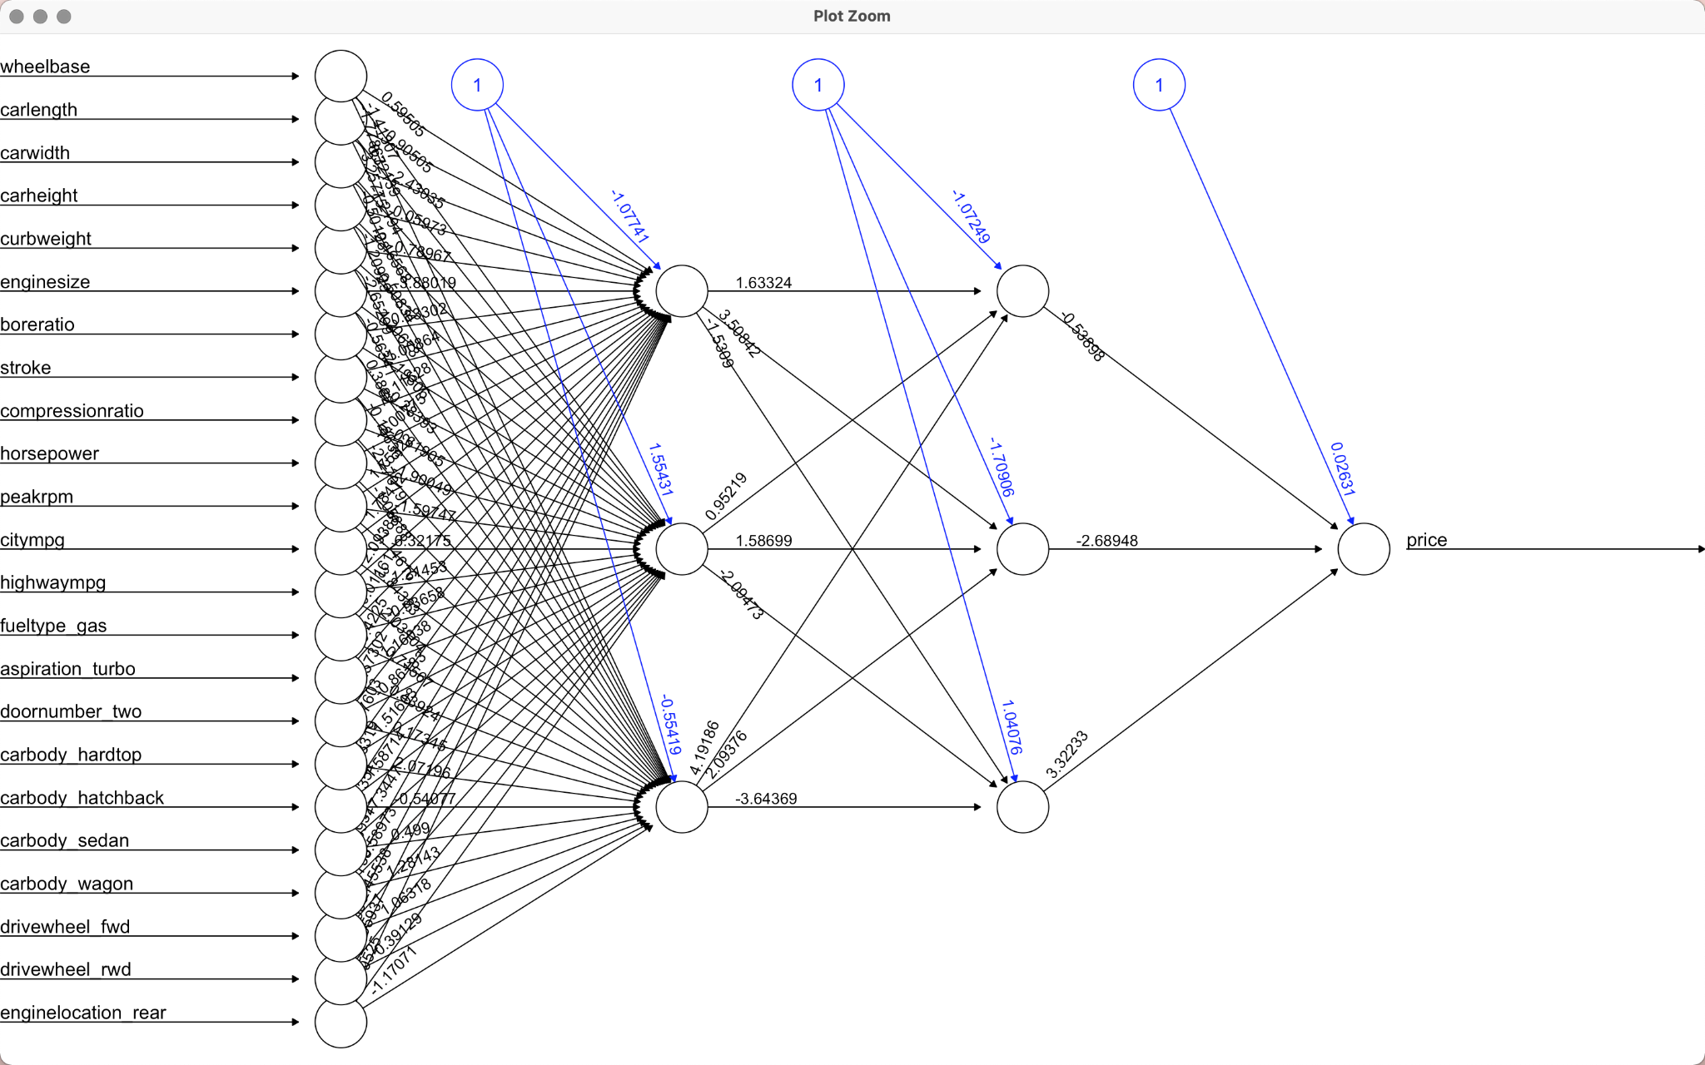
Neural Net _
RMSE for 2 hidden layers of 3 nodes is 2894.68
Notes:
Zoe

Slide 18
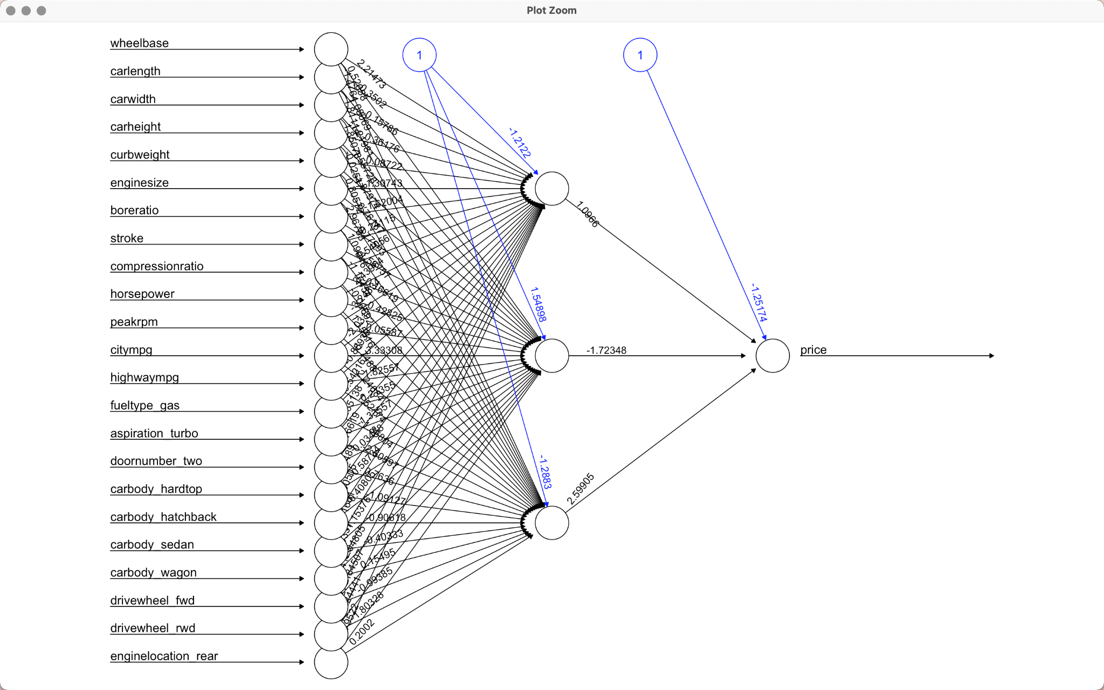
Neural Net _
RMSE for with 1 hidden layer of 3 nodes is 2861.89
Notes:
Zoe

Slide 19
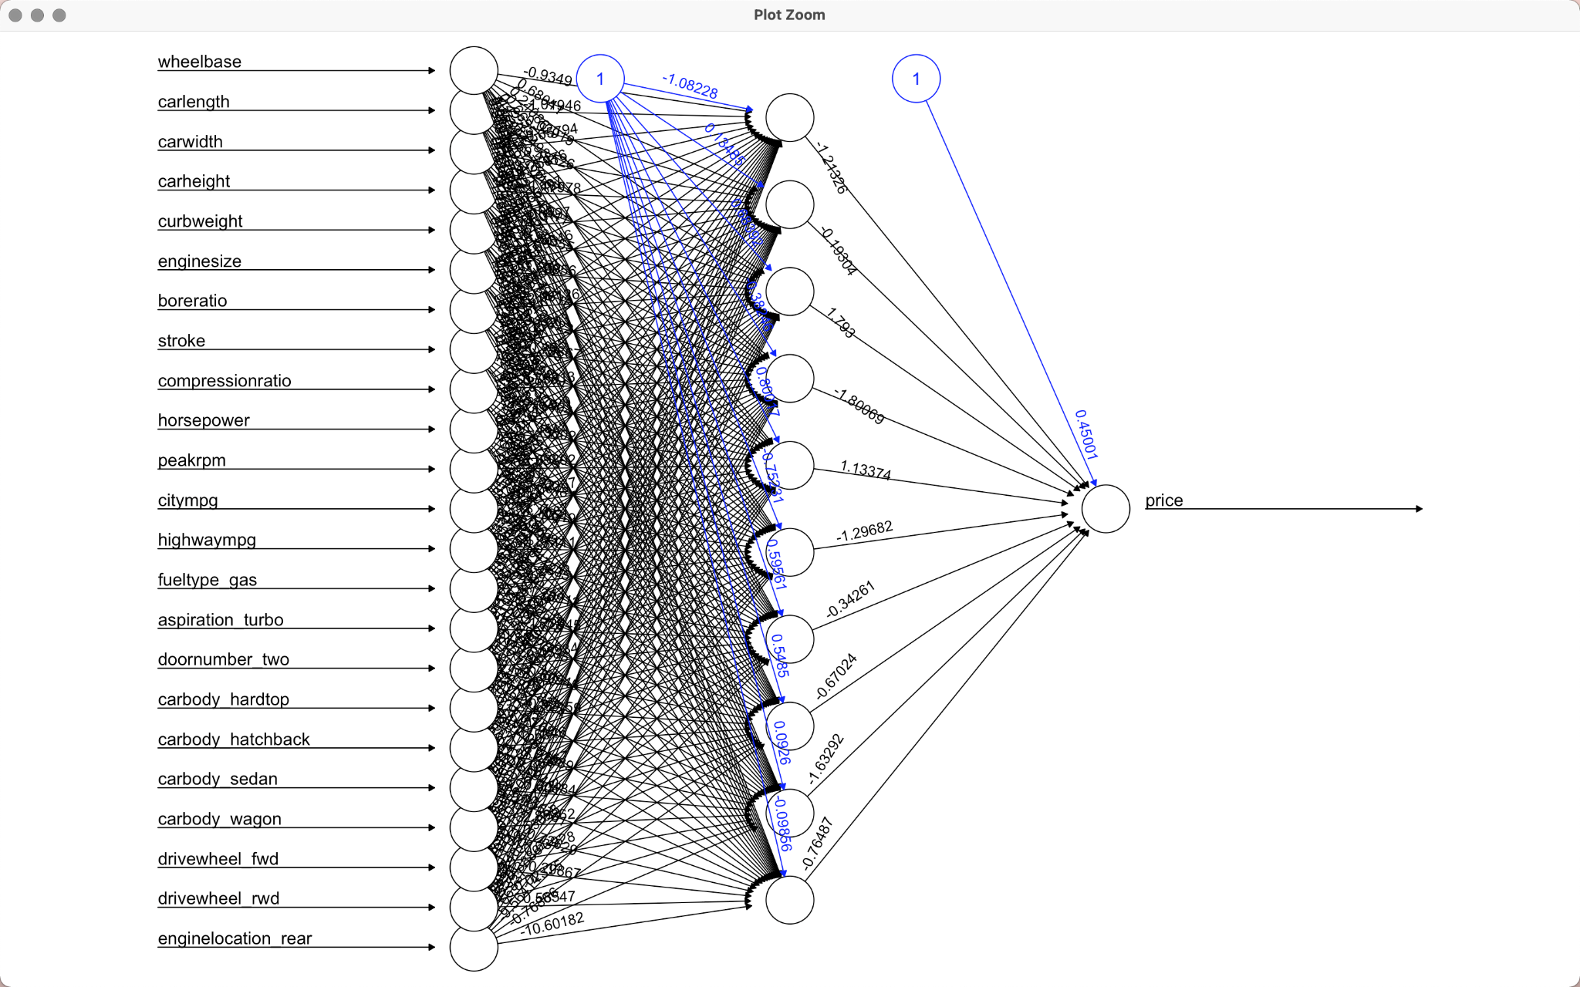
Neural Net _
RMSE for 1 hidden layer of 10 nodes is 3591.92
Notes:
Zoe

Slide 20
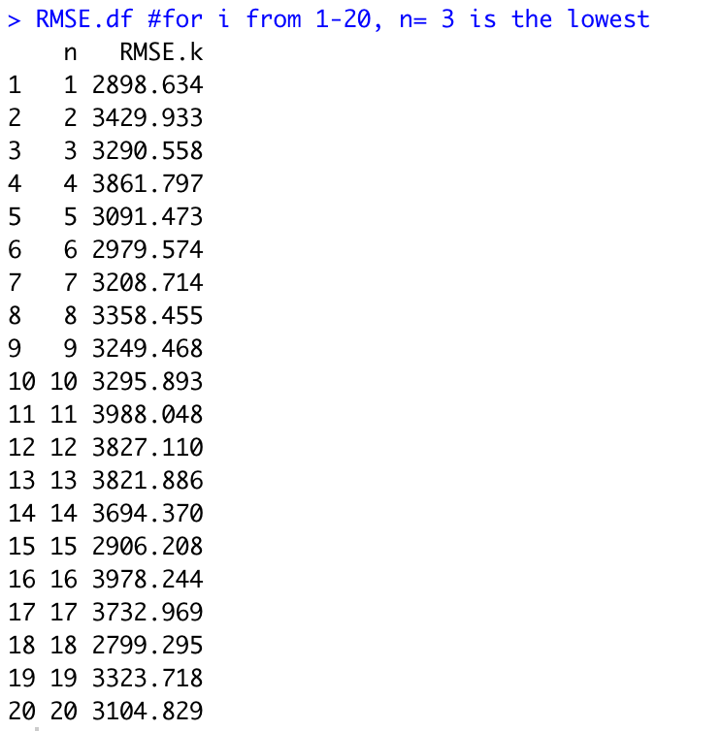
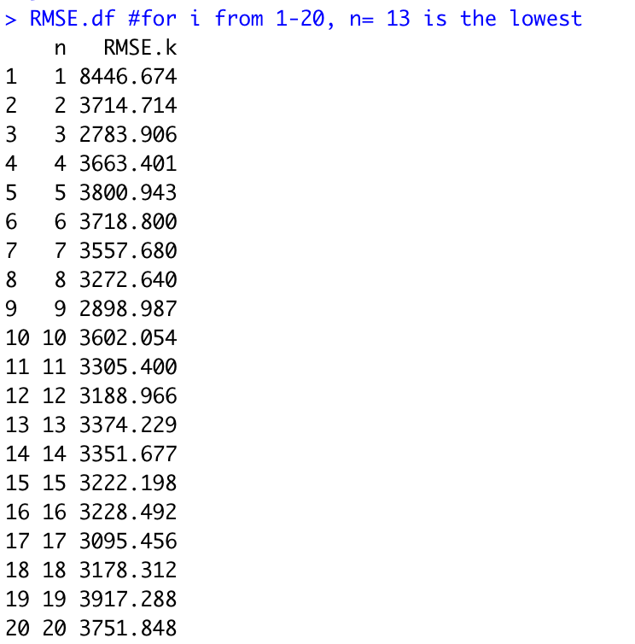
Neural Net _ loop through different hidden layer sizes and conclusion
Look as some of the charts from the slides above, we see the neural net with 1 hidden layers with 3 nodes have the lowest RMSE (2861).
Look as the compare chart above, we see 3 should be the best nodes as well.
-> The more nodes does not mean the better the result will be.
Notes:
Zoe

Slide 21
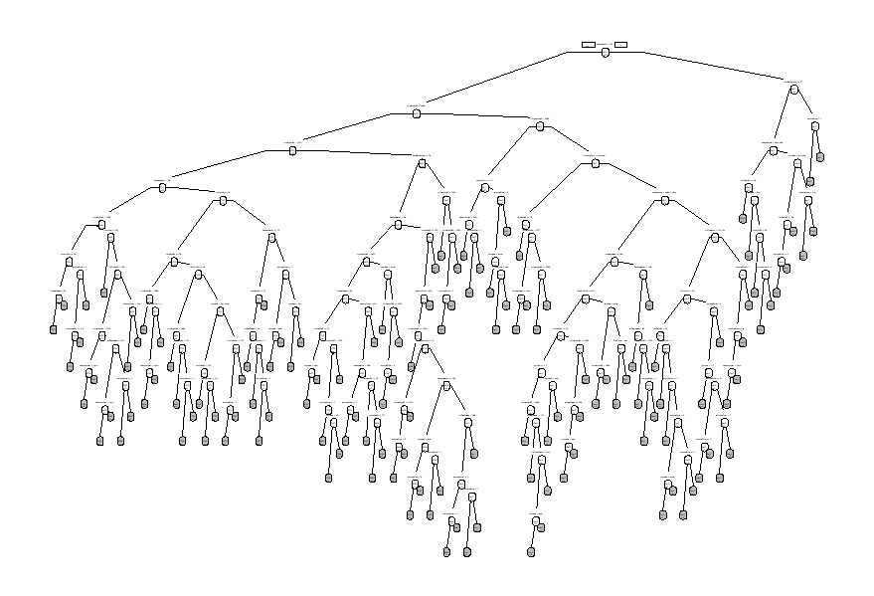
Full Regression Tree
The full regression tree has 133 leaves
It also has an RMSE of 2976.7111
Notes:
Logan

Slide 22
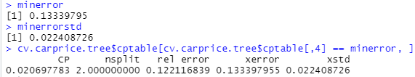
Pruning the Tree
Minerror Tree
After creating a list of all the trees possible, here we found the one with the minimum error
The minimum error was 0.13339795
The minimum standard error was 0.22408726
Thus we created a list of trees with a CP less than 0.35748521 (0.13339795 + 0.22408726)
This gave us tree number 3 of the simpler trees list
Number of splits: 2
CP: 0.0206977832241560
Prune Tree 3
Notes:
Logan

Slide 23
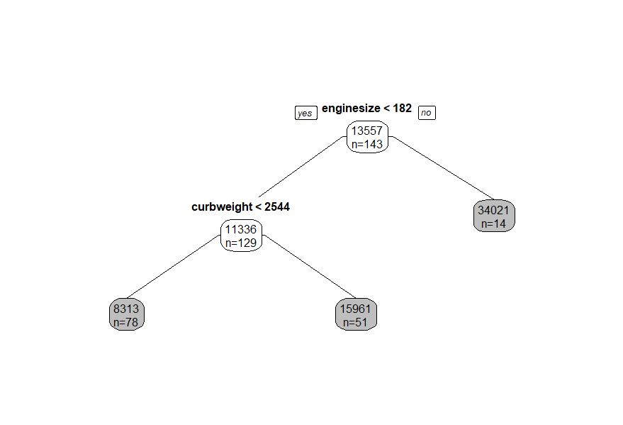
Pruned Regression Tree
Here is the smallest pruned tree from our simpler trees list
It only has 2 splits making it a very simple tree
The tree has 3 leaves
However, the tree had an RMSE of 3397.3841, which was higher than RMSE of our full tree of 2976.7111.
This means that our pruned tree was performing worse than the full regression tree
Our belief was that this was because although the tree was the simplest of the trees with an x error lower than that of the smallest xerror plus the x standard error, it was performing worse because there were so few splits in predicting the price
Notes:
Logan

Slide 24
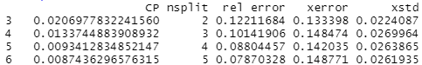
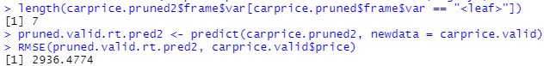
Finding the Best Pruned Regression Tree
In order to correct the problem of the pruned tree performing worse than the full tree, we explore different CP values to find a pruned tree with the best performance and not too many splits
We found that the tree with the lowest RMSE that fit these qualifications was tree number 6
CP: 0.0087436296576315
Number of Splits: 5
RMSE: 2936.4774
Here we used tree 6
Notes:
Logan

Slide 25
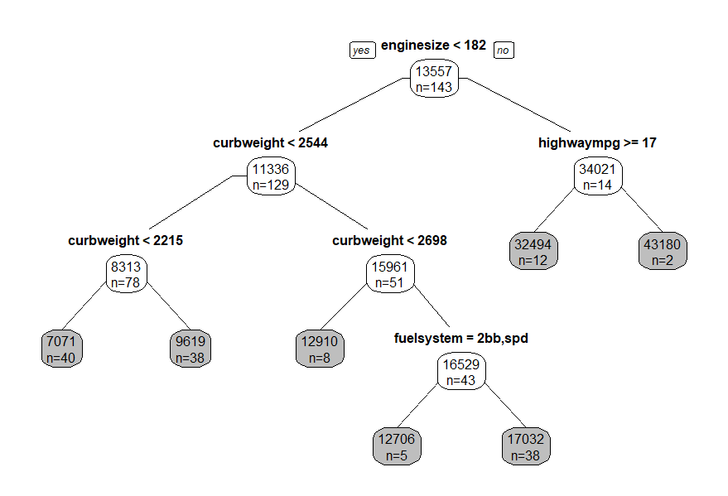
Best Pruned Regression Tree
Here is the pruned regression tree with the best RMSE
This tree has 7 leaves
It predicts better than both our original pruned tree and the full regression tree
Notes:
Logan

Slide 26
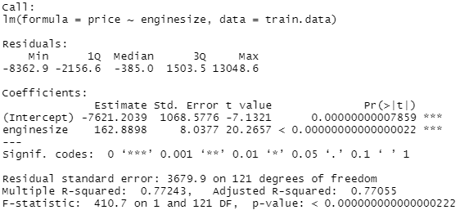
Best Model from Exhaustive Search
The best model from the the exhaustive search ended up having just one variable
Enginesize
The had a very low p-value making it very significant to the model
The best model had
R-squared: 0.7724270
Adjusted R-squared: 0.77054634
CP: 244.0404837
BIC: -172.45065
Notes:
Logan

Slide 27
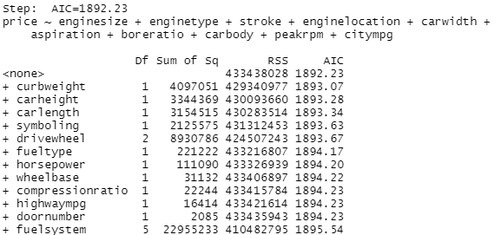
Forward Selection
The most important predictors for predicting price in order are as follows:
Enginesize, engine type, stroke, engine location, car width, aspiration, boreratio, carbody, peakrp, and citympg
Citympg was the least significant of the 10 variables
Enginesize is the most significant of the 10
Forward Selection results in a 10 predictor model
AIC = 1892.23. Adding the other variables would increase the AIC
Notes:
Logan

Slide 28
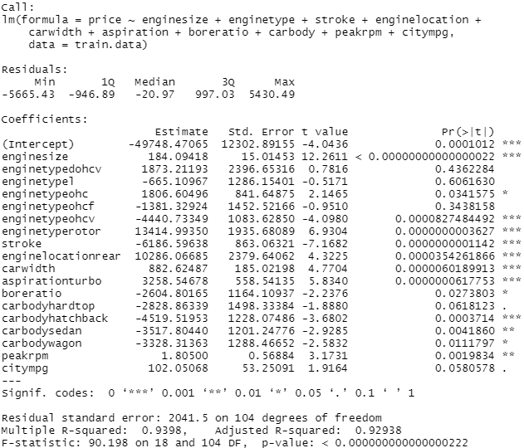
Forward Selection Model
Notes:
Logan

Slide 29
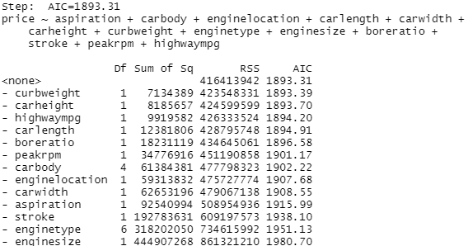
Backwards Selection
The backwards selection model ended up with an AIC of 1893.31
These were the variables it selected:
aspiration
carbody
enginelocation
carlenght
carwidth
carheight
curbweight
enginetype
enginesize
boreratio
stroke
peakrpm
highwaympg
Notes:
Logan

Slide 30
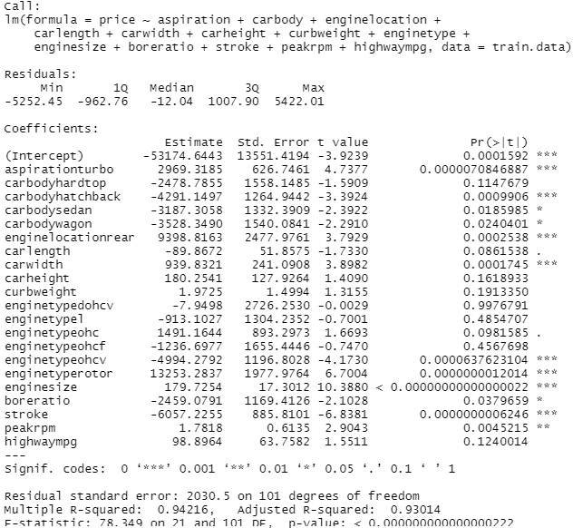
Backwards Selection Model
Notes:
Logan

Slide 31
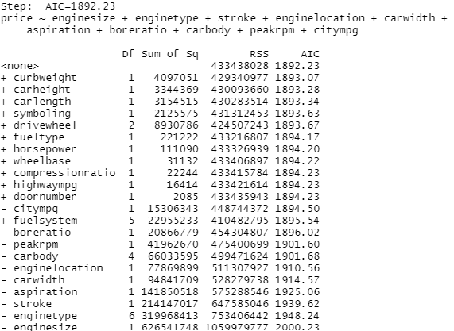
Stepwise Regression
The most important predictors for predicting price in order are as follows:
Enginesize, engine type, stroke, engine location, car width, aspiration, boreratio, carbody, peakrp, and citympg
Citympg was the least significant of the 10 variables
Enginesize is the most significant of the 10
Stepwise Regression also results in a 10 predictor model
AIC - 1892.23. Adding any additional variables would increase this AIC
Notes:
Logan

Slide 32
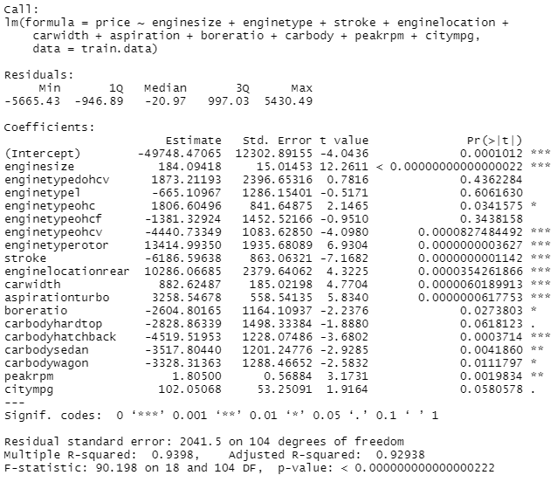
Stepwise Regression Model
Notes:
Logan

Slide 33
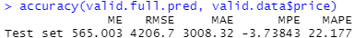
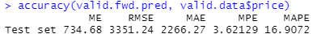
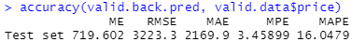
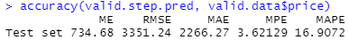
Predictive Performance
Exhaustive Search Model
Forward Selection Model
Backwards Selection Model
Stepwise Regression Model
The backwards selection model ended up with the best model out of our exhaustive searches because of having the lowest RMSE as well as the highest AIC. Therefore we recommend our backwards selection model out of the searches.
Notes:
Logan

Slide 34
Conclusion
Full Tree Predicted Better than pruned tree. In order to correct the problem of the pruned tree performing worse than the full tree, we explored different CP values to find a pruned tree with the best performance and not too many splits. This ended up giving us a best pruned tree with 5 splits and a CP of 0.0087436296576315.
After our comparison, R-squared, adjusted R-squared, mallow's CP values and shows BIC value of all variables. Finally, the most important variables to predicting price are enginesize, enginetype, stroke, enginelocation, carwidth, aspiration, boreratio，carbody, and citympg.
The model we recommend for best predicting the price of a car would be the neural net with 1 hidden layer of 3 nodes. This is because it had the lowest RMSE of all of our models at 2861.89. As a secondary option, we recommend using the 5 split best pruned tree to predict price. This is because it had the second lowest RMSE of all of our models at 2936.4774.
Notes:
Zhou

Slide 35
References
No detailed references were listed for this dataset
Link for dataset: https://www.kaggle.com/code/goyalshalini93/car-price-prediction-linear-regression-rfe/data
Notes:
Jillian

Slide 36
Thank You!
Notes:
Jillian

